Slide 1
Bases de Dados Databases
SQL – Structured Query Language
Data Definition Language (DDL) and Data Manipulation Language (DML)
Nuno Escudeiro – nfe@isep.ipp.pt

Slide 2
Sumário Outline
SQL – Structured Query Language
Data Definition Language
Data Manipulation Language
Regular Expressions

Slide 3
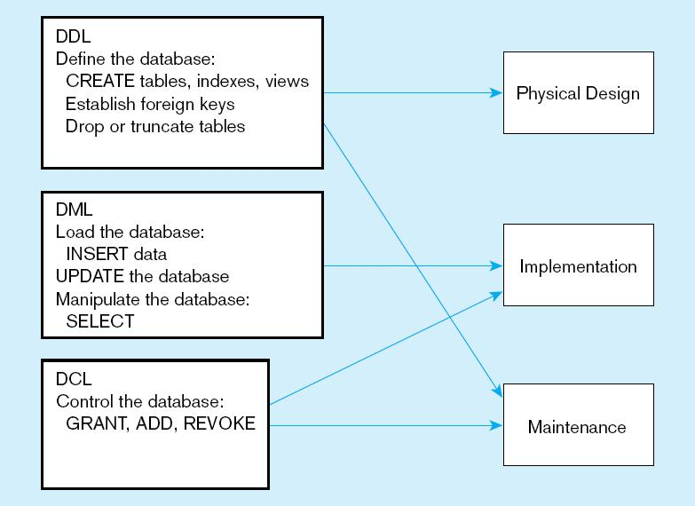
SQL- Strutured Query Language
SQL is more than a structured interrogation language. Includes characteristics for defining the data structure, for changing the data in a database, and for specifying security schemes. These characteristics are grouped as follows:

Slide 4
Sumário Outline
SQL – Structured Query Language
Data Definition Language
Data Manipulation Language
Regular Expressions

Slide 5
SQL- Data Definition Language
Major CREATE statements:
CREATE SCHEMA–defines a portion of the database owned by a particular user
CREATE TABLE–defines a new table and its columns
CREATE VIEW–defines a logical table from one or more tables or views

Slide 6
SQL Data Types
CHAR(n) - Stores string valuues containing any characters in a character set. Char is defined to be a fixed length.
VARCHAR(n)- Stores strings values containing any characters in a character set but of definable variable length.
NCHAR e NVARCHAR2- are Unicode datatypes that store Unicode character data. In Oracle database server, the NVARCHAR2 data type uses AL16UTF16 character set which encodes Unicode data in the UTF-16 encoding. The AL16UTF16 use 2 bytes to store a character.
INTEGER ou int - Stores exact numbers with a predefined and scale.
NUMBER(precise, scale) - Stores exact number with a defined precise and scale.
DATE - - dates between 4712-01-01 BC and 4712-12-31 AD; stores dates from the century through year, month, day, hour, minute and second​;
TIMESTAMP- Data + hora in same column. Stores a moment na event occurs,

Slide 7
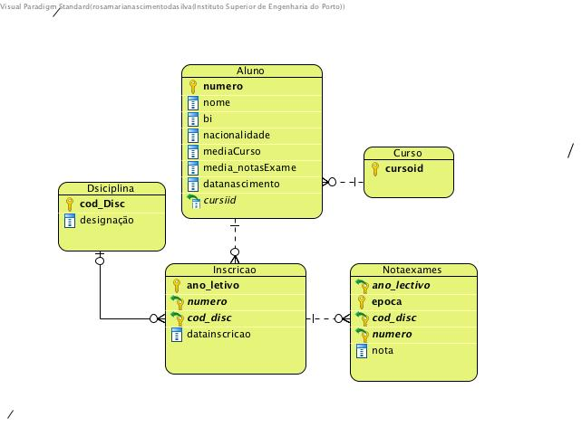
DDL - Steps In Table Creation
Identify data types for attributes
Identify columns that can and cannot be null
Identify columns that must be unique (candidate keys)
Identify primary key and foreign key
Determine default values
Identify constraints on columns (domain specifications)
Create the table and associated indexes

Slide 8
DDL – Create Table
most basic form - indicate the name of the table, the names of the various columns and the type of each one of them.​
CREATE [schema_name.]table_name (
column_name data_type [NULL | NOT NULL] [inline_constraint] [DEFAULT default_value],
...
out_of_line_constraints );
create table student ( ​ codnumber integer, ​ name varchar (100),​ nrcc integer, ​ nationality varchar(30) ),​ averageCourse number (4,2),​ ...... ); ​

Slide 9
DDL – Create Table , defining attributes and their data types
Default values can also be set for each column using the default keyword.
create table aluno (
numero integer ,
nome varchar (100),
bi integer,
nacionalidade varchar(30) default ‘Portuguesa’
mediaCurso number (4 ,2) default 10,
media_notasExame number (4 ,2),
datanascimento date
cursoid integer );

Slide 10
Data Integrity Controls
In SQL constraints of various types can be defined.
Integridad constraints: define the primary key and the foreign key with the referenced table and primary key.
Value constraints:define whether null values are not allowed. (single values are required, and whether only a given set of values are allowed in a column).
A constraint can be created at the same time that the table is created or can be added to the table later.
There are two levels at which a constraint is defined:
Inline (column level )- declare on the same line as the column when creating a table.;
Out-of-line (table level)- declared on a separate line for the column. We add it at the end of the CREATE TABLE statement.

Slide 11
Identifying primary keys
Constraints - Primary Key If the primary key is composed of an attribute, we must use a inline constraint ;
If the primary key is composed of more than one attribute we must use a out-of-line constraint.
create table student ( codnumber integer Primary Key, name varchar(100), nrcc integer nationality varchar(30) default 'Portuguese’ averageCourse number (4,2) default 10, average_gradeexams number (4.2), date_birth date , cursoid integer );
create table enollment (
year number(4),
codnumber integer,
cod_disc number(4),
dataenrollment date,
constraint pk_cexamef Primary key (year, codnumber,cod_disc));
We Should always give a name to restriction. It easier to identify the reason why data entry fails.

Slide 12
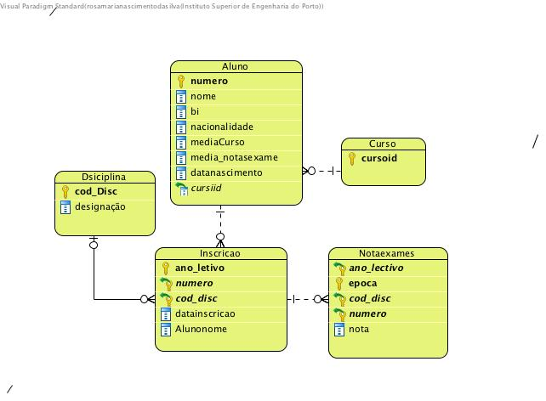
Identifying foreign keys and establishing relationships
A foreign key restriction allows you to declare foreign keys.
A foreign Key should always reference a primary Key.
A foreign key constraint requires values in one table to match values in another table.
create table student ( codNumber integer Primary key, name varchar (100), nrcc integer, nationality varchar(30) ) default 'Portuguese’, gradeCourse number (4,2) default 10, average_grade_exams_number (4.2), date_birth date , cursoid integer references course(cursoid) );
attribute that is primary key in the course table

Slide 13
Identifying foreign keys and establishing relationships
In case the foreign key is composed (more than one column) we must use a out-of-line constraint:
create table Exams ( year number(4), time varchar(20), cod_disc number(4), codnumber integer, grade number(4,2), ........... Constraint fk_grade Foreign Key (year, cod_disc, codnumber) references enrollment (year, cod_number, cod_disc));

Slide 14
Constraint - Check
Check type constraints allow you to ensure that one or more columns follow a certain rule (can be expressed as a mathematical expression).
create table student ( codnumber integer primary key, name varchar (100), nrcc integer, nationality varchar(30) ) default 'Portuguese’, averageCourse number (4,2) , Constraint ck_average check (averageCourse >= 10 and averge >=20), averages_grade number (4.2), date_birth date ...... );

Slide 15
Constraint - check
In case the constraint covers more than one column we must use a out-of-line constraint.
create table student (
cod_number integer Primary Key,
name varchar (100) ,
nrcc integer ,
Nationality varchar(30) default ‘Protuguesa',
averageCourse number (4 ,2),
average_grade number (4 ,2),
date_birth date,
constraint ck_averageExam check (average_grade < averageCourse)
......... );

Slide 16
Identifying Null Values
There’s only one constraint type that can be declared as an inline constraint. This is the NOT NULL constraint.
To ensure that a column does not have null values we can use a restriction of type not null
create table student (
cod_number integer Primary Key,
name varchar (100) not null,
nrcc integer ,
nationality varchar(30) default ‘Protuguesa',
averageCourse number (4 ,2) ,
average_grade number (4 ,2),
date_birth date,
constraint ck_average_exam check (average_grade < averageCourse)
......... );

Slide 17
Identifying Unique values
Candidate keys can be defined using unique constraints.
These restrictions are equivalent to primary key constraints but do not require values to be non-null.
create table student (
Cod_number. integer Primary Key,
name varchar (100) not null,
nrcc integer unique ,
Nationality. varchar(30) default ‘Protuguesa,
averageCourse number (4 ,2) ,
average_grade number (4 ,2),
date_birth date,
constraint ck_averageExam check (average_grade < averageCourse)
......... );

Slide 18
Creating a Table with an IDENTIFY column
GENERATED ALWAYS AS IDENTITY -> The sequence generator always provides an IDENTITY value. We cannot specify a value for the column. GENERATED BY DEFAULT AS IDENTITY -> The sequence generator provides an IDENTITY value whenever a column value is not provided. GENERATED BY DEFAULT ON NULL AS IDENTITY -> The sequence generator provides the next IDENTITY value if we specify a NULL column value.
GENERATED (ALWAYS | (BY DEFAULT [ON NULL])) AS IDENTITY [sequence_options,...]
Example: create table company ( Id_empresa iNTEGER GENERATED ALWAYS AS IDENTITY CONSTRAINT pk_company PRIMARY KEY, namecompany varchar2(50), locality VARCHAR2(18) );

Slide 19
Changing Tables
You can change tables Add new columns, change the data type, and delete columns;
Add or remove constraints. Add a column ALTER TABLE STUDENT ADD (email varchar(100))
Delete a column ALTER TABLE Student DROP column email
Change the data type of a column ALTER TABLE Student MODIFY (email varchar(75))
ALTER TABLE table_name
ADD column_name column_definition;
ALTER TABLE table_name
DROP COLUMN column_name;
ALTER TABLE table_name
MODIFY column_name column_type;
DROP TABLE [schema_name].table_name [ CASCADE CONSTRAINTS ] [ PURGE ];

Slide 20
Changing constraints
Eliminate a constraint ALTER TABLE Student DROP CONSTRAINT FK_Nota_id_aluno_Aluno Add a constraint
ALTER TABLE Student ADD CONSTRAINT FK_Nota_id_aluno_Aluno FOREIGN KEY (id_aluno) REFERENCES Student(id_aluno)
Considerations:
The syntax of commands can be different from DBMS to DBMS;
Not all DBMS allow all versions of the ALTER TABLE command;
When you add a constraint, you must always specify in the form of out-of-line constraint;
Changing the data type of a column cannot violate constraint rules.
ALTER TABLE table_name DROP CONSTRAINT constraint_name;
ALTER TABLE table_name ADD CONSTRAINT constraint_name XXXX (column1, column2, ... column_n);

Slide 21
Sumário Outline
SQL – Structured Query Language
Data Definition Language
Data Manipulation Language
Regular Expressions

Slide 22
Data Manipulation Language
Data Manipulation Language (DML) is used to perform selection, sorting, calculation of information stored in tables, among others.
COMMANDS:
INSERT - insert data into a table; UPDATE - updates existing data in a table; DELETE - deletes records in a table; SELECT- retrieve data from the database.

Slide 23



INSERT STATEMENT
Adds one or more rows to a table
Inserting into a table
Inserting a record that has some null attributes requires identifying the fields that actually get data
Inserting from another table

Slide 24
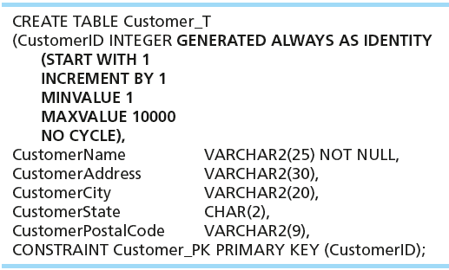
INSERT STATEMENT
Inserting into a table does not require explicit customer ID entry or field list
INSERT INTO CUSTOMER_T VALUES ( ‘Contemporary Casuals’, ‘1355 S. Himes Blvd.’, ‘Gainesville’, ‘FL’, 32601);

Slide 25
Delete Statement
Removes rows from a table
Delete some rows
DELETE FROM CUSTOMER_T WHERE CUSTOMERSTATE = ‘HI’;
Delete all rows
DELETE FROM CUSTOMER_T;

Slide 26

UPDATE STATEMENT
Modifies data in existing rows
determines which table will perform the changes.
indicates pairs of columns and values to assign to columns.
update <table>
set <Atribute> = <ExpressIon>, <Atribute> = <Expression>, ...
where <Condition>
indicates about which record the table will perform the changes. The condition can be a subquery).

Slide 27
Sumário Outline
SQL – Structured Query Language
Data Definition Language
Data Manipulation Language
Regular Expressions

Slide 28
Regular Expressions
A Regular Expression is a pattern of characters used to math diferent combinations of strings or characters
REGEXP_LIKE ( string expression, pattern [, matching parameter ] )
string expression - the string expression.
pattern - the regular expression match pattern
matching parameter - allows you to change the default matching behavior of the Oracle REGEXP_LIKE function (For example, change the search from upper and lowercase to uppercase and lowercase).
Correct use of REGEXP_LIKE conditions-> the NLS_SORT parameter must be equal to BINARY. To change the value of this parameter, run the following command:
ALTER SESSION SET NLS_SORT=BINARY;

Slide 29
Regular Expressions
Exemple:
CREATE TABLE UTENTE(
ID_USER CHAR(7) PRIMARY KEY,
USERNAME VARCHAR(25) NOT NULL UNIQUE,
PASSWORD VARCHAR(25) NOT NULL,
DATA_SIGNUP DATE DEFAULT SYSDATE,
EMAIL VARCHAR(40) NOT NULL UNIQUE,
CONSTRAINT CK_REG_US CHECK(REGEXP_LIKE(USERNAME '^Ste(v|ph)en$');
username starts with Ste and ends with en and in the middle is v or ph
CONSTRAINT CK_REG_US CHECK(REGEXP_LIKE(USERNAME 'l{2}', 'i’)
username that contain exactly two letters L/l (case-insensitive)

Slide 30
Regular Expressions
Regular Expression Operators

